Slide 1

Event Booking System
Created by
Faisal Alghamdi

Slide 2
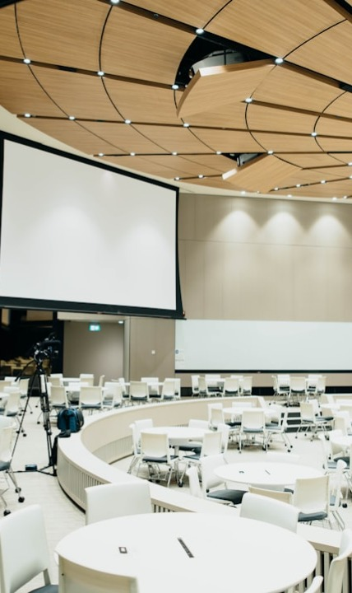
Project Summary
Discover & Book Events
A system that helps users easily discover and book events while giving hosts control over capacity, ticketing, and performance tracking.

Slide 3

Problems
• Event Discovery Issues
• Manual Booking
• Lack of Insights

Slide 4
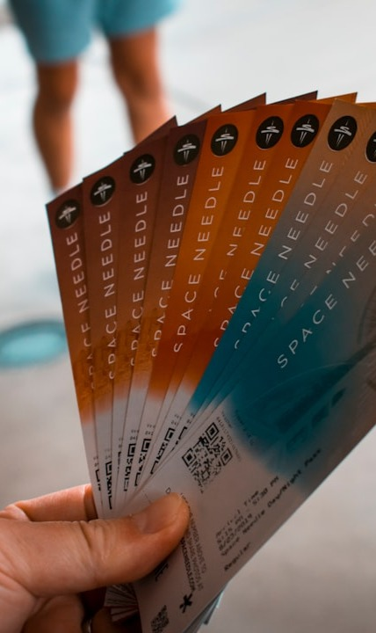
Scenario
Without the System
Users struggle with endless scrolling and lack of guidance. Events are often overbooked, poorly confirmed, and manual check-ins slow. Hosts miss post-event engagement.

Slide 5

Solutions
• One platform for events
• Online booking
• Data Collection

Slide 6

Host Flow
Create & Manage Events
Monitor Performance

Slide 7

User Flow
Discover & Book Events
Receive & Use Tickets

